Slide 1

Technical preparation for the course
DSB 2022

Slide 2
What is git?
Git is a free open-source distributed version control system designed to handle everything from small to very large projects with speed and efficiency.

Slide 3

Why to use git?
One of the biggest advantages of Git is its branching capabilities. Unlike centralized version control systems, Git branches are cheap and easy to merge. This facilitates the feature branch workflow popular with many Git users.

Slide 4
Git configurations
Download git and install it https://git-scm.com/
Open Git Bash
Start Configurations of User
Write following commands in Git Bash terminal
git config --global user.name “Name Surname” (Write your own name and surname)
git config --global user.email “youremail@mail.com” (Write your email that you used for registration in bitbucket/github)
git config --system core.longpaths true (in case if you will face an error open PowerShell as an administrator and run it
git config --global core.autocrlf true (in case if you will face an error open PowerShell as an administrator and run it)

Slide 5

SSH-KEY
SSH keys are a pair of public and private keys that are used to authenticate and establish an encrypted communication channel between a client and a remote machine over the internet.
To generate your own SSH KEY type following command in git bash
ssh-keygen (click enter two times to use default configurations)

Slide 6
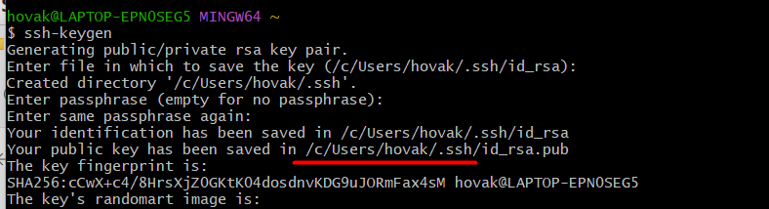
SSH KEY ACTIVATION Part 1
Go to .ssh folder and open id_rsa.pub file using any text editor that you want (Notepad, Notepad++ etc) and copy all the text. Be sure that it’s not private key.
You can find path of the folder under ssh-keygen command.

Slide 7
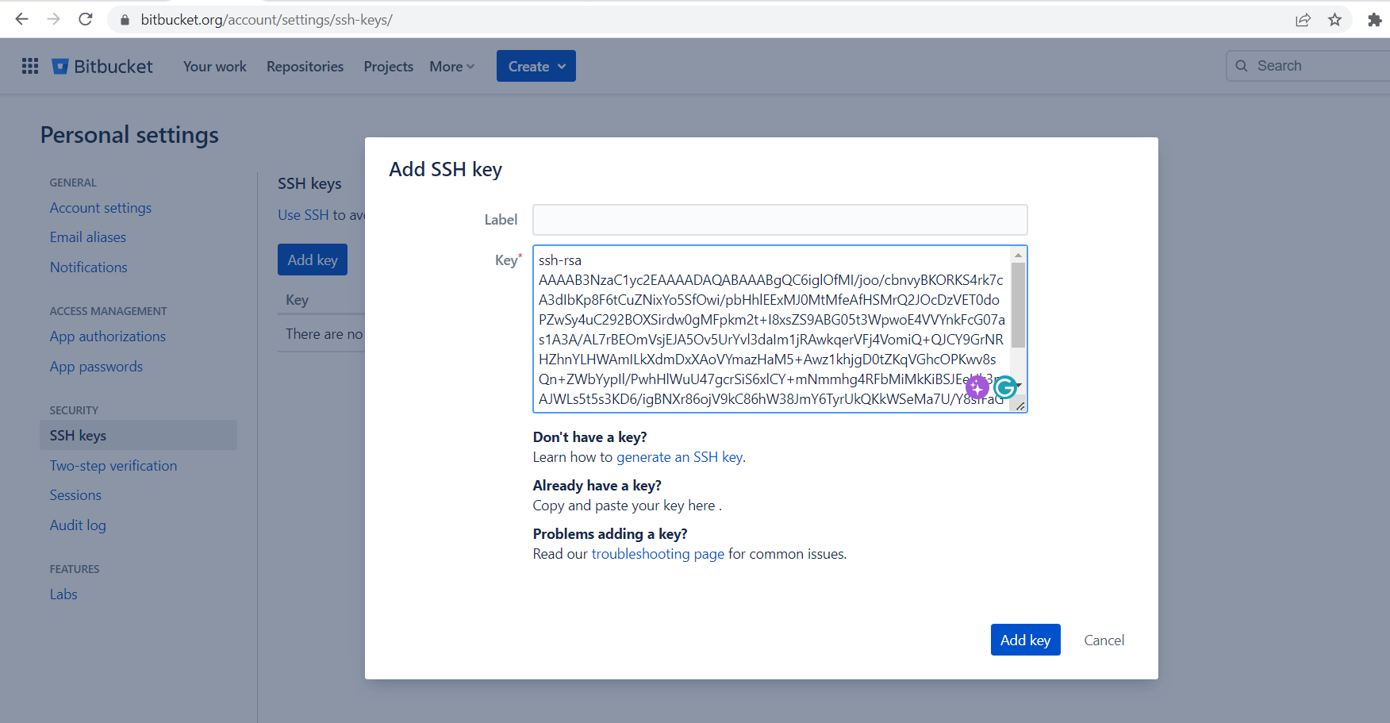
SSH KEY ACTIVATION Part 2
Go to bitbucket account settings SSH Keys subsection
https://bitbucket.org/account/settings/ssh-keys/
Click on add key button, paste your public ssh key and click on add key.

Slide 8
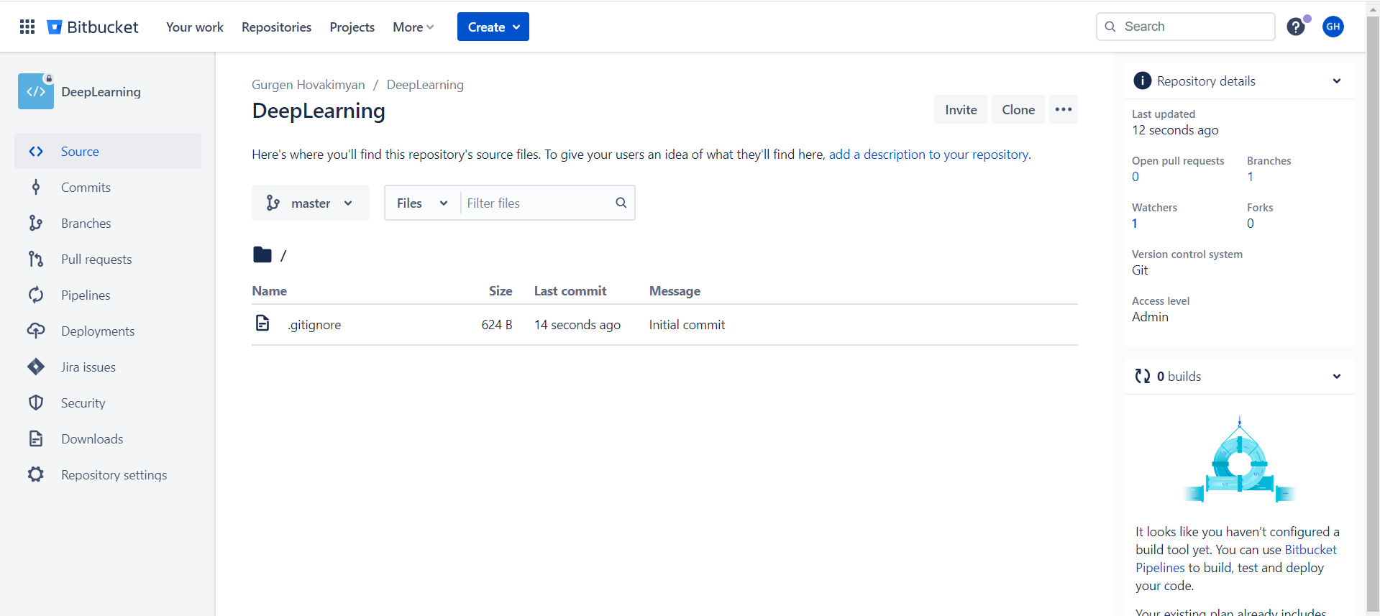
Creating Repository And Cloning Part 1
Go to bitbucket main page and create on create repository button
https://bitbucket.org/dashboard/overview
Type name of the repository and click create.
You will see following window. Click on clone button and copy the text.

Slide 9
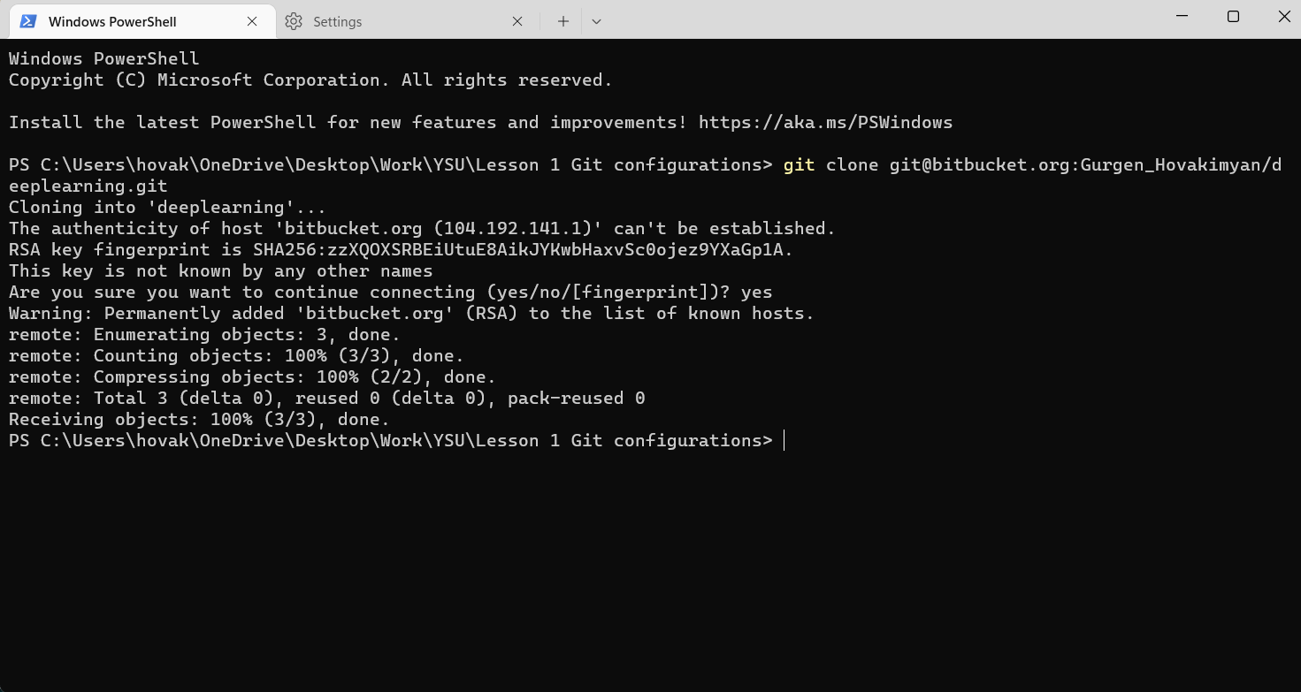
Git clone Part 2
Open a folder where you want to clone repository. Open any of terminals (cmd, PowerShell, Git Bash) in that folder and paste the command.

Slide 10
Git commands Status
Go to directory that you cloned:
cd <dir_name>
Check status of your git repository:
git status (you will see that you are on master branch and there is nothing to commit)
Add new file to the repository, it can be anything that you want, after type git status again. You will see that there is one untracked change highlighted with red

Slide 11
Git commands Add/Restore
To make your changes available in remote directory first you must select which files you want to add in remote directory using git add command
git add <file name>
In case if you want to add all files you can just type
git add .
After check status again. If you by accident added wrong file you can unstage it using following command (don’t do it now)
git restore <file name>

Slide 12
Git commands Commit
Before adding your changes in remote repository, you must write a message what about your changes are, so other members of you team can understand it. Use following command
git commit –m “message”

Slide 13
Git commands Push
Finally, after committing changes we are ready to add it in our remote repository. To do that we can use push command
git push origin <branch name>
Go to bitbucket and check if your changes are committed successfully.

